Slide 1
Chapter 1:
Sampling and Descriptive Statistics
September 3, 2020
© 2020 by McGraw-Hill Education.
This is proprietary material solely for authorized instructor use. Not authorized for sale or distribution in any manner.
This document may not be copied, scanned, duplicated, forwarded, distributed, or posted on a website, in whole or in part.
Notes:
Page: 1

Slide 2
Why Statistics?
Deal with uncertainty in repeated scientific measurements.
Draw reliable conclusions from data.
Design valid experiments and draw reliable conclusions.
Be a well-informed member of society.
Notes:
Page: 1

Slide 3
Example 1 1
A machine makes steel rods for use in optical storage devices. The specification for the diameter of the rods is 0.45 ± 0.02 cm. During the last hour, the machine has made 1000 rods for a shipment. A quality control engineer wants to know approximately how many of these rods meet the specification but he does not have time to measure all 1000 rods.
So he draws a random sample of 50 rods, measures them, and finds that 46 of the rods (or 92%) meet the diameter specification. It is unlikely that the sample of 50 rods represents the population of 1000 perfectly—the proportion of good rods in the population is likely to differ somewhat from the sample proportion.
Notes:
Page: 2

Slide 4
Example 1 2
The engineer might need to answer several questions based on the sample data. For example:
How large is a typical difference between the sample proportion and the population proportion for this kind of sample?
What interval gives a good estimate of the percentage of acceptable rods in the population with reasonable certainty?
How certain can the engineer be that at least 90% of the rods are good?
Statistics can help us to address questions like these.
Notes:
Page: 2

Slide 5
Section 1.1: Sampling 1
Definitions:
A population is the entire collection of objects or outcomes about which information is sought.
A sample is a subset of a population, containing the objects or outcomes that are actually observed.
A simple random sample (S R S) of size n is a sample chosen by a method in which each collection of n population items is equally likely to comprise the sample, just as in the lottery.
Notes:
Page: 3

Slide 6
Example 2
At a large university with about 40,000 students, a professor is interested in the average height of students at the university.
She obtains a list of all 40,000 students enrolled at the university, and assigns a number to each student. She uses a computer random number generator to generate 100 random integers between 1 and 40,000, and the students corresponding to those numbers are selected to have their heights measured.
This is a simple random sample since every possible sample of size 100 has the same chance of being selected.
Notes:
Page: 3

Slide 7
Section 1.1: Sampling 2
Definition: A sample of convenience (or a convenience sample) is a sample that is obtained in some convenient way and is not drawn by a well-defined random method.
Example: Surveying only a few of your friends/ roommates/ classmates for a campus-wide study.
Convenience samples may differ systematically in some way from the population.
Thus, they should only be used when it is not feasible to draw a random sample.
If you do have a convenience sample, think carefully about the ways in which the sample might differ systematically from the population.
Notes:
Page: 4

Slide 8
Example 3
A construction engineer has received a shipment of 1000 concrete blocks, each weighing roughly 50 pounds. The blocks are in a large pile.
The engineer wishes to investigate the crushing strength of the blocks by measuring the strengths in a sample of 10 blocks.
It may be difficult to take a S R S since that would involve getting blocks from the middle and bottom of the pile, so the engineer may just take 10 of the blocks off the top.
This would be a sample of convenience.
Some other examples of non-random samples are self-select samples and volunteer samples (which usually don’t resemble the corresponding population).
Notes:
Page: 4

Slide 9
Simple Random Sampling
Even though, a simple random sample (S R S) is one of the best sampling methods to obtain a representative sample it is not guaranteed to reflect the population perfectly.
S R S’s always differ in some ways from each other; occasionally, a sample is substantially different from the population.
Two different samples from the same population will vary from each other as well.
This phenomenon is known as sampling variation.
Notes:
Page: 5

Slide 10
Example 1 (revisited) 3
Remember the rod example?
In the sample the engineer collected, there were 92% that met specification.
In the population of all 1000 rods, it is unlikely that exactly 92% will meet specification.
Due to sampling variation, it is more realistic to think that the true proportion of rods meeting specification will be close to the sample proportion, or 92%.
Question: How much error can we reasonably expect in this estimation for the actual proportion?
We will address this question in chapter 5 (with margin of error analysis for confidence interval estimation).
Notes:
Page: 6

Slide 11
More on S R S 1
Definition: A finite population that consist of actual physical objects/ people is called a tangible population. On the other hand, a conceptual population consists of all of the values that might possibly have been observed (from repeated trials).
For example, a geologist weighs a rock several times on a sensitive scale. Each time, the scale gives a slightly different reading.
Here the population is conceptual. It consists of all the readings that the scale could in principle produce.
Similarly, consider flipping a coin repeatedly. This is also a conceptual population as there is no limit on the number of tosses that can be performed.
Notes:
Page: 6

Slide 12
Independent/ Dependent Items
The items in a sample are said to be (statistically) independent if knowing the values of some of the items does not help to predict chances for the values of the other items.
Similarly, if knowing the values of some of the items affects the chances of the other items, then these items are said to be dependent.
For example, consider rolling a six-sided die twice. Since the result of one roll doesn’t change the chance of the outcomes for the other roll, these two rolls are independent.
Question: Can you give an example of a sample with dependent items/ events?
Notes:
Page: 8

Slide 13
More on S R S 2
A simple random sample (SRS) could be performed with or without replacement of the items already selected. When it is done with replacement, then the items selected are independent.
However, in most applications (especially in surveys/ polls), we don’t want to include the same person/ item in the sample again. So, it is done without replacement. In this case, the items are dependent.
Items in a simple random sample (without replacement) may be treated as independent in most cases encountered in practice. The exception occurs when the population is finite and the sample comprises a substantial fraction (more than 5%) of the population.
Notes:
Page: 8

Slide 14
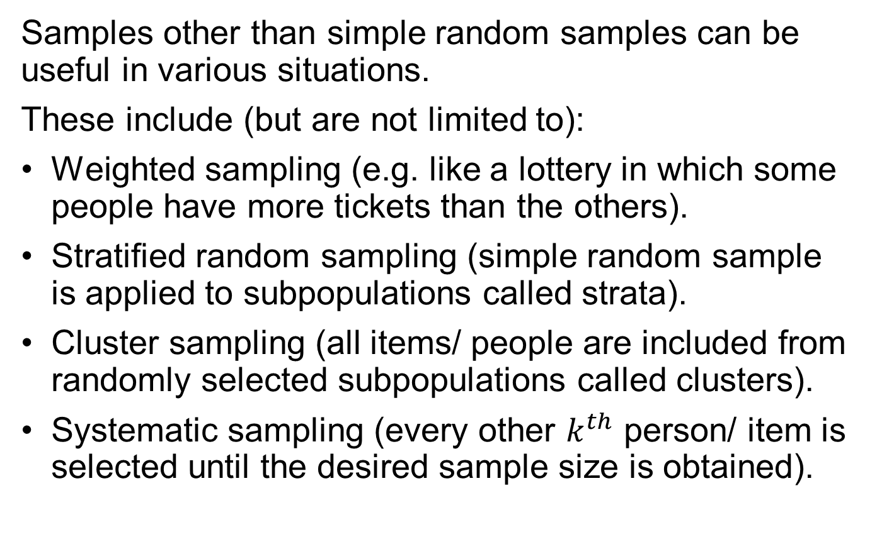

Other Sampling Methods
Samples other than simple random samples can be useful in various situations.
These include (but are not limited to):
Weighted sampling (e.g. like a lottery in which some people have more tickets than the others).
Stratified random sampling (simple random sample is applied to subpopulations called strata).
Cluster sampling (all items/ people are included from randomly selected subpopulations called clusters).
Systematic sampling (every other $k^{th}$ person/ item is selected until the desired sample size is obtained).
Notes:
Page: 10

Slide 15
Types of Studies/ Experiments
Many types of experiments can be used to generate data.
One-sample experiments involve only one population of interest with a single sample drawn from it.
Multi-sample experiments involve two or more populations of interest with a single sample drawn from each population.
In many multi-sample experiments, the populations can be distinguished from one another by varying one or more factors that may affect the outcome of interest.
Notes:
Page: 11

Slide 16
Types of Data
When a numerical quantity designating how much or how many is assigned to each item in the sample, the resulting set of values is numerical or quantitative. Some examples:
Height (in centimeters).
Weight (in kilograms).
Age (in years).
When sample items are placed into categories and category names are assigned to the sample items, the data are categorical or qualitative.
Hair color.
Country of origin.
Zip code.
Notes:
Page: 11

Slide 17
Controlled Experiments and Observational Studies 1
A controlled experiment is one in which the experimenter controls the values of the factors.
A controlled experiment involves a control group and one or more treatment groups.
After obtaining a random/ representative sample, researchers also need to form control and treatment groups using “random assignment”.
When designed and conducted properly, controlled experiments can produce reliable information about cause-and-effect relationships between factors and response.
Notes:
Page: 11

Slide 18
Controlled Experiments and Observational Studies 2
An observational study is one where the experimenter simply observes the factors as they are, without having any control over them.
Observational studies are not nearly as good as controlled experiments for obtaining reliable conclusions regarding cause and effect.
When a sample result is obtained based on a (representative) random sample, such a result can be generalized to the population.
Notes:
Page: 11

Slide 19
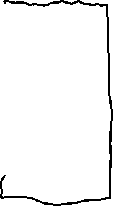


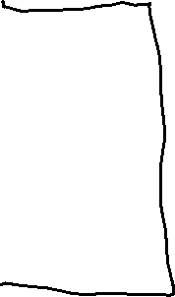









Slide 20

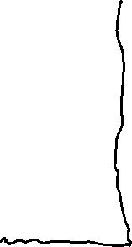


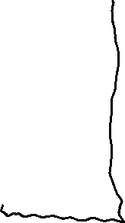





Slide 21


Slide 22

Section 1.2: Summary Statistics
A sample is often a long list of numbers.
To help make the important features of a sample stand out, we compute summary (or descriptive) statistics.
A sample mean, trimmed mean, median or mode gives an indication of the center of the data. These are examples of measures of center.
The sample standard deviation, range or interquartile range gives an indication of how spread out the data are. These are called measures of spread/ variability/ dispersion.
When the sample mean is used as a measure of center, then the standard deviation is used as a measure of spread (for variability around the mean).
Notes:
Page: 14

Slide 23




More on Summary Statistics 1
Let
be a sample, and ∑ denote summation.
Sample Mean: The sample mean (average) is
Sample Variance:
Sample standard deviation is the square root of the sample variance, and is denoted by s.
Notes:
Page: 14

Slide 24
More on Summary Statistics 2
The sample mean (the arithmetic average) is also the physical balance point of a data set .
Both the variance and standard deviation are non-negative. They are zero if there is no deviation in the data (all observations are equal to the mean).
Sample standard deviation represents a typical distance from the sample mean. In most applications, about 60%-80% of the values are within one standard deviation from the mean.
Note that both mean and standard deviation are sensitive to the changes in data, especially in extreme values.
Notes:
Page: 14

Slide 25
More on Summary Statistics 3
If
is a sample, and
where a
and b are constants, then
If
is a sample, and
where a
and b are constants, then
Such linear transformations may occur when units in the measurements change (e.g. from Fahrenheit to Celsius).
Notes:
Page: 16

Slide 26
Outliers
Outliers are points that are much larger or smaller than the rest of the sample points.
Outliers may be data entry errors or they may be points that really are different from the rest.
Outliers should not be deleted without considerable thought—sometimes calculations and analyses will be done with and without outliers and then compared.
There are different procedures to detect outlier, depending on whether mean or median is used as a measure of center.
Notes:
Page: 17

Slide 27
Mode and Median
The mode is the most frequent value in a data set. There may be multiple modes if two or more values occur the most. It may not exist either.
Note that mode can also apply to categorical data.
The median is the middle number of the ordered data values.
Since the median is a measure that is away from the extreme values, it is not affected by the changes in the smallest or largest observations.
Such measures are called resistant measures.
Note: Mean and standard deviation are not resistant.
Notes:
Page: 17

Slide 28
Finding the Sample Median
Order the n data points from smallest to largest.
Then:
If n is odd, the sample median is the number in
position
If n is even, the sample median is the average
of the numbers in positions
Notes:
Page: 17

Slide 29
Quartiles 1
Quartiles divide the data as nearly as possible into quarters. However, the procedures to determine their values differ. So, you may get a slightly different result depending on whether you use a particular graphing calculator or statistical program/ software/ spreadsheet.
The first quartile, denoted Q1, is the median of the lower half of the data.
To find the first quartile, compute 0.25(n + 1). If this is an integer, then the sample value in that position is the first quartile. If not, take the average of the sample values on either side of this value.
Notes:
Page: 19

Slide 30
Quartiles 2
The third quartile, denoted Q3, is the median of the upper half of the data.
To find the third quartile, compute 0.75(n + 1). If this is an integer, then the sample value in that position is the third quartile. If not, take the average of the sample values on either side of this value.
Note: The computation we used for the location of the median is equivalent to 0.5(n +1). The median is the second quartile, Q2.
Notes:
Page: 19

Slide 31
Definition of Percentile
The pth percentile of a sample, for a number p between 0 and 100, divides the sample so that as nearly as possible p% of the sample values are less than the pth percentile, and (100 − p)% are greater.
The computation of the location of the pth percentile is analogous to what we did for the quartiles. However note that there are slightly different procedures, especially when using technology. So, don’t be surprised to get results which change form one method/ technology to other.
Notes:
Page: 20

Slide 32
To Find Percentiles
Order the n sample values from smallest to largest.
Compute the quantity
where n is the
sample size.
If this quantity is an integer, the sample value in this position is the pth percentile. Otherwise, average the two sample values on either side.
Notes:
Page: 20

Slide 33
Note on Percentiles
The first quartile is the 25th percentile.
The median is the 50th percentile.
The third quartile is the 75th percentile.
Notes:
Page: 20

Slide 34
Example 4
Suppose we have the following data:
2, 3, 5, 6, 7, 9, 9, 11, 12, 15
What is the mean of these data?
What is the median?
What is the first quartile?
What is the third quartile?
Notes:
Page: 20

Slide 35
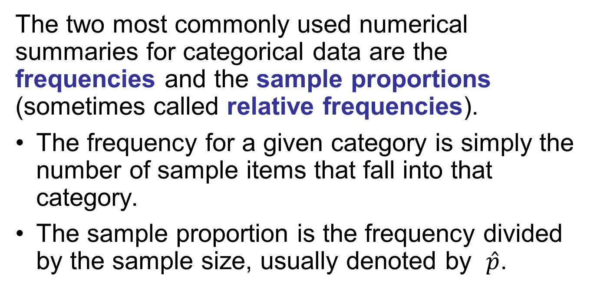
Summary Statistics for Categorical Data 1
The two most commonly used numerical summaries for categorical data are the frequencies and the sample proportions (sometimes called relative frequencies).
The frequency for a given category is simply the number of sample items that fall into that category.
The sample proportion is the frequency divided by the sample size, usually denoted by $\hat{p}$.
Notes:
Page: 22

Slide 36
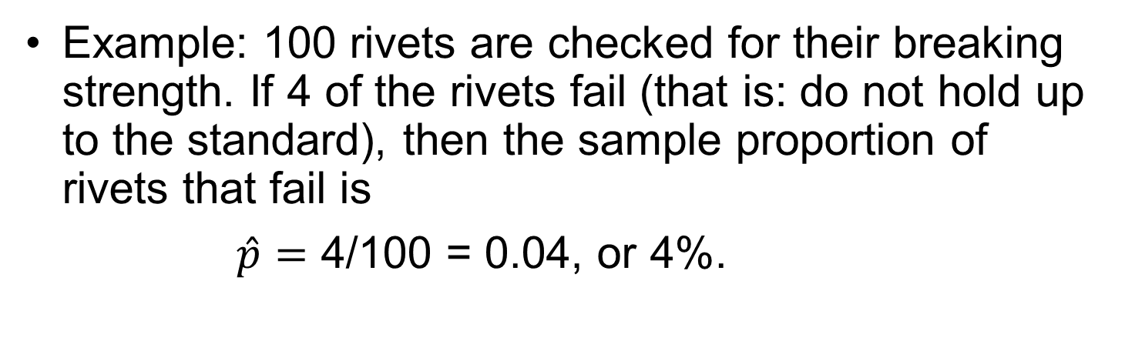
Summary Statistics for Categorical Data 2
Example: 100 rivets are checked for their breaking strength. If 4 of the rivets fail (that is: do not hold up to the standard), then the sample proportion of rivets that fail is
$\hat{p}=$ 4/100 = 0.04, or 4%.
Notes:
Page: 22

Slide 37
Sample Statistics and Population Parameters
Each sample statistic in this chapter has a population parameter counterpart.
Numerical summaries of a sample are called statistics.
Numerical summaries of a population are called parameters.
Statistics are often used to estimate parameters.
Population parameters like population mean and population standard deviation are usually denoted by some Greek letters. For example, µ denotes a population mean and σ denotes a population standard deviation.
Notes:
Page: 23

Slide 38
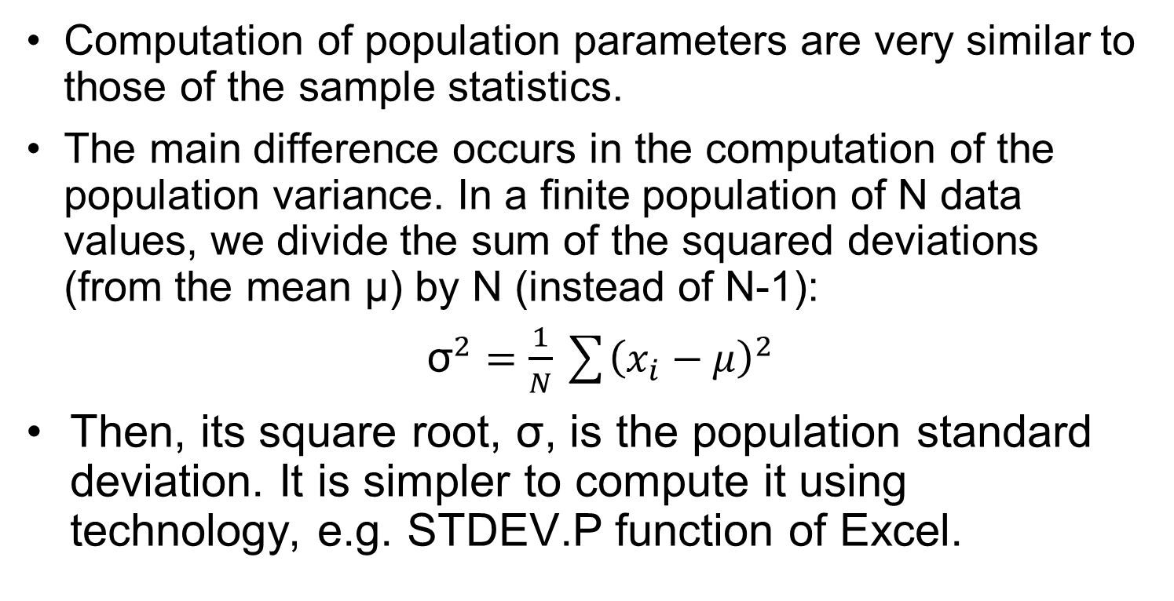
Population Variance
Computation of population parameters are very similar to those of the sample statistics.
The main difference occurs in the computation of the population variance. In a finite population of N data values, we divide the sum of the squared deviations (from the mean µ) by N (instead of N-1):
${\text{σ}}^{2}=\frac{1}{N}\sum{{\left(x_{i}−μ\right)}^{2}}$
Then, its square root, σ, is the population standard deviation. It is simpler to compute it using technology, e.g. STDEV.P function of Excel.
Notes:
Page: 23

Slide 39
Section 1.3: Graphical Summaries
Stem-and-leaf plot.
Dotplot.
Histogram.
Boxplot.
Scatterplot.
Notes:
Page: 25

Slide 40
Stem-and-Leaf Plot
A simple way to summarize a data set.
Each item in the sample is divided into two parts: a stem, consisting of the leftmost one or two digits, and the leaf, which consists of the next digit.
It is a compact way to represent the data, especially for medium-size data sets.
It also gives us some indication of the shape of our data.
Notes:
Page: 25

Slide 41
Example 5 1
Example: Duration of dormant periods of the geyser Old Faithful in Minutes.
Stem-and-leaf plot:
Stem | Leaf
4 | 259
5 | 0111133556678
6 | 067789
7 | 01233455556666699
8 | 000012223344456668
9 | 013
Let’s look at the first line of the stem-and-leaf plot. This represents measurements of 42, 45, and 49 minutes.
A good feature of these plots is that they display all the sample values. One can reconstruct the data in its entirety from a stem-and-leaf plot, although some digits may be truncated.
Notes:
Page: 25

Slide 42
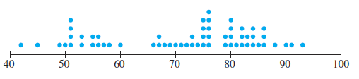
Dotplot
A dotplot is a graph that can be used to give a rough impression of the shape of a sample, giving a good indication of where the sample values are concentrated and where the gaps are.
It is useful when the sample size is not too large and when the sample contains some repeated values.
It is a good method, along with the stem-and-leaf plot, to informally examine a sample. However, they are rarely used in formal presentations.
Example (geyser data):
Notes:
Page: 26

Slide 43
Histogram
Graphical display that gives an idea of the “shape” of the sample, indicating regions where sample points are concentrated and regions where they are sparse.
The bars of the histogram touch each other. A space indicates that there are no observations in that interval.
Notes:
Page: 27

Slide 44
Creating a Histogram
Choose boundary points for the class intervals. Usually these intervals are the same width.
Compute the frequencies: this is the number of observations that occur in each interval.
Compute the relative frequencies for each class: this is the number of observations in each interval divided by the total number of observations.
If the class intervals are the same width, then draw a rectangle for each class, whose height is equal to the frequencies or relative frequencies.
If the class intervals are of unequal widths, the heights of the rectangles must be set equal to the densities, where density is the relative frequency divided by the class width.
Notes:
Page: 27

Slide 45
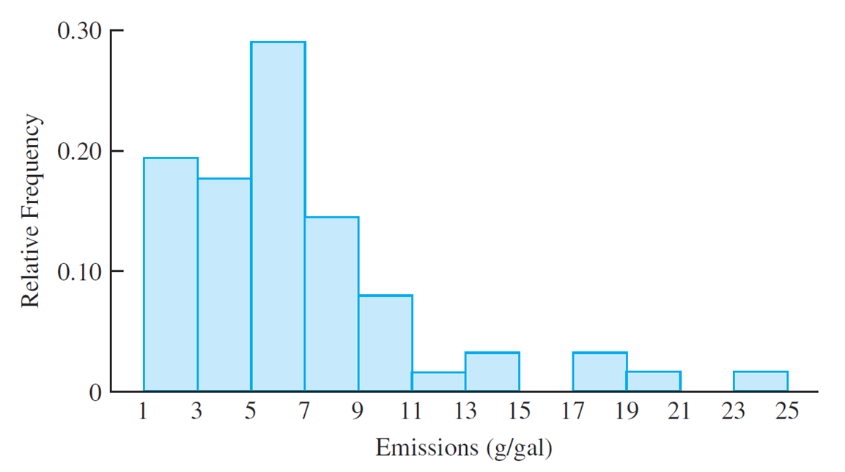
Example of Histogram
Notes:
Page: 28

Slide 46
Symmetry and Skewness 1
A histogram is perfectly symmetric if its right half is a mirror image of its left half.
For example, the distribution of birth weights of full-term infants is roughly symmetric.
Histograms that are not symmetric are referred to as skewed.
A histogram with a long right-hand tail is said to be skewed to the right, or positively skewed.
For example, the distribution of household incomes is right-skewed.
A histogram with a long left-hand tail is said to be skewed to the left, or negatively skewed.
For example, the distribution of grades on an easy test is left-skewed.
Notes:
Page: 31

Slide 47
Symmetry and Skewness 2
When a histogram is roughly symmetric, the mean and the median are approximately equal.
When a histogram is right-skewed, the mean is greater than the median.
When a histogram is left-skewed, the mean is less than the median.
Notes:
Page: 31

Slide 48
Unimodal and Bimodal
A histogram with only one peak is what we call unimodal.
If a histogram has two peaks then we say that it is bimodal.
Bimodal histograms often indicate subsamples.
If there are more than two peaks in a histogram, then it is said to be multimodal.
Multimodal histograms do not often occur in practice.
Notes:
Page: 31

Slide 49
Boxplots
A boxplot is a graphic that presents the median, the first and third quartiles, and any outliers present in the sample.
The interquartile range (I Q R) is the difference between the third quartile and the first quartile. This is the distance needed to span the middle half of the data.
Notes:
Page: 33

Slide 50
Creating a Boxplot
Compute the median and the first and third quartiles of the sample. Indicate these with horizontal lines. Draw vertical lines to complete the box.
Find the largest sample value that is no more than 1.5 I Q R above the third quartile, and the smallest sample value that is no more than 1.5 I Q R below the first quartile. Extend vertical lines (whiskers) from the quartile lines to these points.
Points more than 1.5 I Q R above the third quartile, or more than 1.5 I Q R below the first quartile, are designated as outliers. Plot each outlier individually.
Notes:
Page: 33

Slide 51
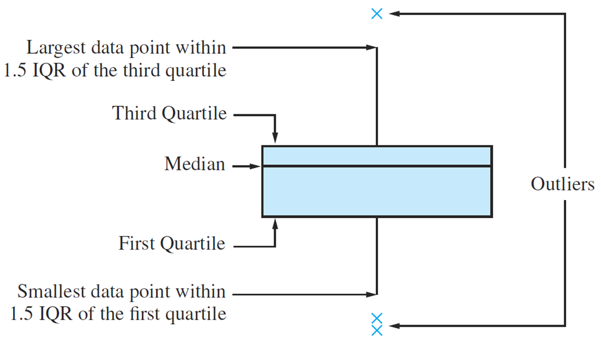
Anatomy of a Boxplot
Notes:
Page: 34

Slide 52
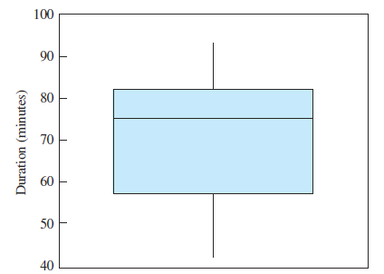
Example 5 2
Notice there are no outliers in these data.
Looking at the four pieces of the boxplot, we can tell that the sample values are comparatively densely packed between the median and the third quartile.
The lower whisker is a bit longer than the upper one, indicating that the data has a slightly longer lower tail than an upper tail.
The distance between the first quartile and the median is greater than the distance between the median and the third quartile.
This boxplot suggests that the data are skewed to the left.
Notes:
Page: 34

Slide 53
Comparative Boxplots
Sometimes we want to compare more than one sample.
We can place the boxplots of the two (or more) samples side-by-side.
This will allow us to compare how the medians differ between samples, as well as the first and third quartile.
It also tells us about the difference in spread between the two samples.
Notes:
Page: 35

Slide 54
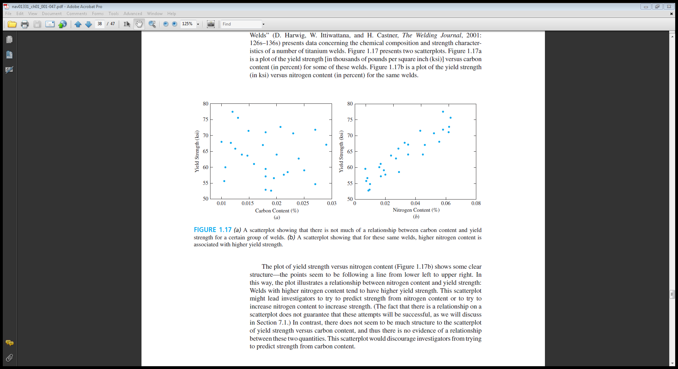
Scatterplot
Data for which items consists of a pair of values is called bivariate.
The graphical summary for bivariate data is a scatterplot.
Display of a scatterplot:
Notes:
Page: 37

Slide 55
Looking at Scatterplots
If the dots in the scatterplot do not appear to have a general trend or pattern, then there is little evidence of a relationship between the two variables.
If the dots on the scatterplot appear to roughly follow a straight line, then there is evidence of a linear relationship between the two variables.
When a linear relationship exists, we may be able to use one variable to help predict the values of the other variable.
Notes:
Page: 38

Slide 56
Summary of Chapter 1
We discussed types of data.
We looked at sampling methods, with an emphasis on simple random sampling (S R S).
We learned about sample statistics.
We examined graphical displays of data.

